Slide 1

What are we going to see in this session?
GitHub
Difference between Git & GitHub
Create first Repository in GitHub
Overview of GitHub dashboard
Pushing local repo to GitHub
Manage your GitHub credentials in environment
Making change in GitHub and pulling the changes to local

Slide 2
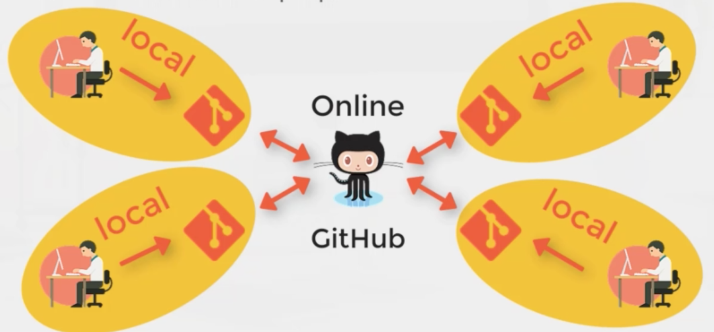
GitHub
GitHub is an online service where you can share your code or files in order to collaborate with different people.
To put in simple words, GitHub would have installed in one centralized machine where ever developers would commit their code from their local machine.

Slide 3
Difference between Git & GitHub
Often people get confuse with Git & GitHub.
Git :
As we know Git is an version control tool which will allow us to manage project locally.
Additionally, we can say git helps us to push & pull the project files to an central server.
GitHub
GitHub is an hosting platform which allows you to host your project files in an remote server.
Beside, we can also consider GitHub is an user friendly public platform with nice visual interface and millions of users sharing their projects to entire world.
Some of more hosting tools are GitLab, Bit-Bucket etc..
If you are new to GitHub, please go-ahead and create your own account in GitHub with your mail ID.

Slide 4
Create first repository in GitHub
Navigate to GitHub page and login with your account.
Click the tab “Repositories”
Click “New”
Provide the ”Repository name”
Choose if it should be “Public or Private”
You can also add ReadMe files which can help others to understand your project.
Create the Repository once all done.

Slide 5
Overview of GitHub dashboard
Overview of what can be done after creating new repo.
How to create folders and files in GitHub.
How to make commit after creating file in GitHub
How to download a file to local machine
Delete the file.
How to find the branch which we are into.
Other widgets like (watch, star, Fork, Settings etc..)

Slide 6
Pushing Local Repo to GitHub
In our case, we have already created the local repository. We just need to push it to GitHub.
To push files to remote server we may need to first setup the remote in local server.
git remote add origin <git-link>
(origin is an optional name here, you can create remote with any name)
Once remote is set our local repo is linked with remote GitHub.
git push origin master
(Right now we are just pushing our codes to Master branch)
Provide your credentials.

Slide 7
Pushing Local Repo to GitHub
In our case, we have already created the local repository. We just need to push it to GitHub.
To push files to remote server we may need to first set the remote in local server.
git remote add origin <git-link>
(origin is an optional name here, you can create remote with any name)
Once remote is set our local repo is linked with remote GitHub.
git push origin master
(Right now we are just pushing our codes to Master branch)
Provide your credentials.

Slide 8
Manage GitHub credentials in environment
Every time when you push the file to GitHub, you may need to provide your GitHub credentials which is bit annoying. Let’s see how to avoid it by storing credentials in as an environment variable.
For that we are going to use credential helper.
git config credential.helper store
git push <git-hub link>
cat ~/.git-credentials

Slide 9
Making change in GitHub and pulling the changes to local
In this scenario, let’s make the change in file at GitHub.
This change will not reflect in local repo however. Let’s see how to pull the changes from GitHub to local repo.
Your local repo can be updated using command.
git pull origin master

Slide 10

End of this topic !
Any questions?

